Slide 1

6th Grade Math
Unit 12, Lesson 5 Writing Descriptions of Real-World Contexts from Algebraic Expressions Volume 2, pg. 303

Slide 2


Benchmark
MA.6.AR.1.1
Given a mathematical or real-world context, translate written descriptions into algebraic expressions and translate algebraic expressions into written descriptions.
volume 2, pg. 303

Slide 3
Integrated Mathematical Thinking and Reasoning Standards
MA.K12.MTR.1.1 Actively participate in effortful learning both individually and collectively.
MA.K12.MTR.2.1 Demonstrate understanding by representing problems in multiple ways.
MA.K12.MTR.4.1 Engage in discussions that reflect on the mathematical thinking of self and others.
MA.K12.MTR.5.1 Use patterns and structure to help understand and connect mathematical concepts.
MA.K12.MTR.7.1 Apply mathematics to real-world contexts.
volume 2, pg. 303

Slide 4

Learning Target
I can write a description of a real-world context from an algebraic expression.
volume 2, pg. 303

Slide 5

Warm-Up
volume 2, pg. 304

Slide 6
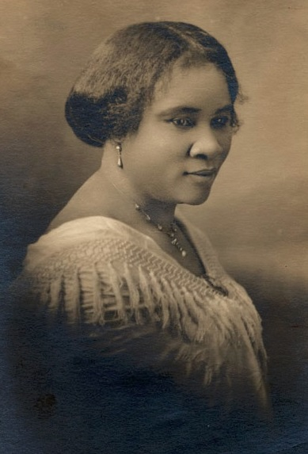
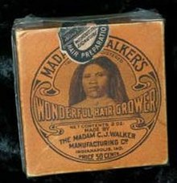
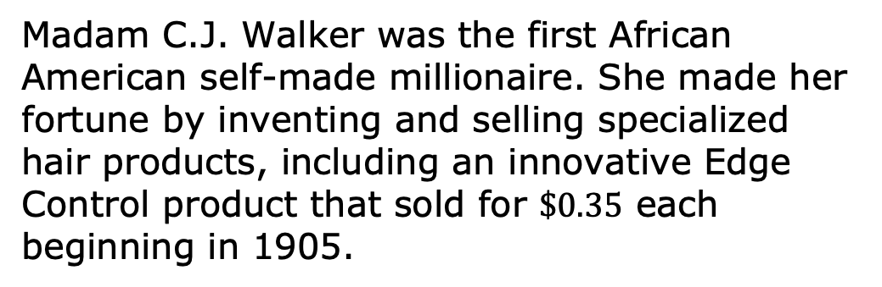
12.5.1 Warm-Up: Self-Made Millionaire
Madam C.J. Walker was the first African American self-made millionaire. She made her fortune by inventing and selling specialized hair products, including an innovative Edge Control product that sold for $\$0.35$ each beginning in 1905.
volume 2, pg. 304

Slide 7
Create an algebraic expression to describe the total revenue Madam C.J. Walker earned for selling any number of Edge Control products, 𝑒.
volume 2, pg. 304

Slide 8

Activity
volume 2, pg. 304

Slide 9


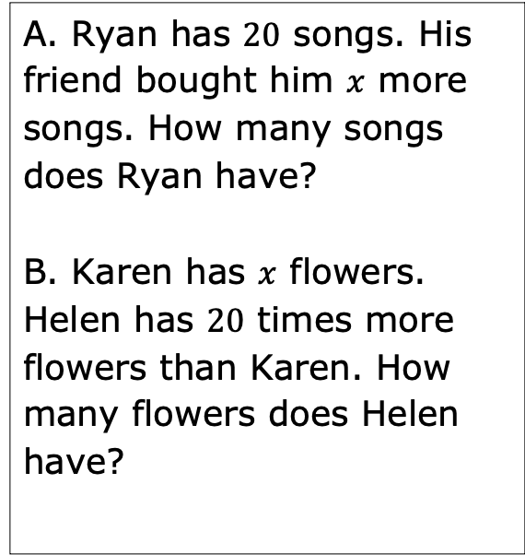
12.5.2 Activity: Matching Real-World Contexts to Expressions
Match each real-world situation with the correct expression.
A. Ryan has $20$ songs. His friend bought him $x$ more songs. How many songs does Ryan have?
B. Karen has $x$ flowers. Helen has $20$ times more flowers than Karen. How many flowers does Helen have?
1. $20x$
2. $x+20$
volume 2, pg. 304

Slide 10


C. George earned $20$ points in a card game. Bruno earned $x$ fewer points than George. How many points did Bruno earn?
D. Maria has $20$ books and wants to put an equal number of books on $x$ bookshelves. How many books go on each shelf?
3. $\frac{20}{x}$
4. $20−x$
volume 2, pg. 304

Slide 11

Collaboration
volume 2, pg. 305

Slide 12

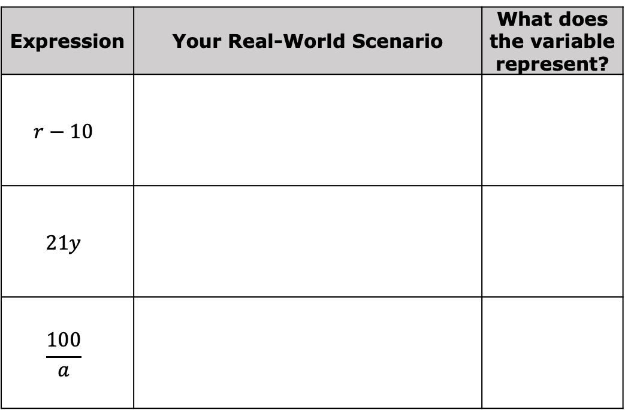
12.5.3 Collaboration: Writing Real-World Contexts
For each expression, create a real-world scenario that the algebraic expression could represent.
Expression | Your Real-World Scenario | What does the variable represent?
$$r−10$$
$$21y$$
$$\frac{100}{a}$$
volume 2, pg. 305

Slide 13
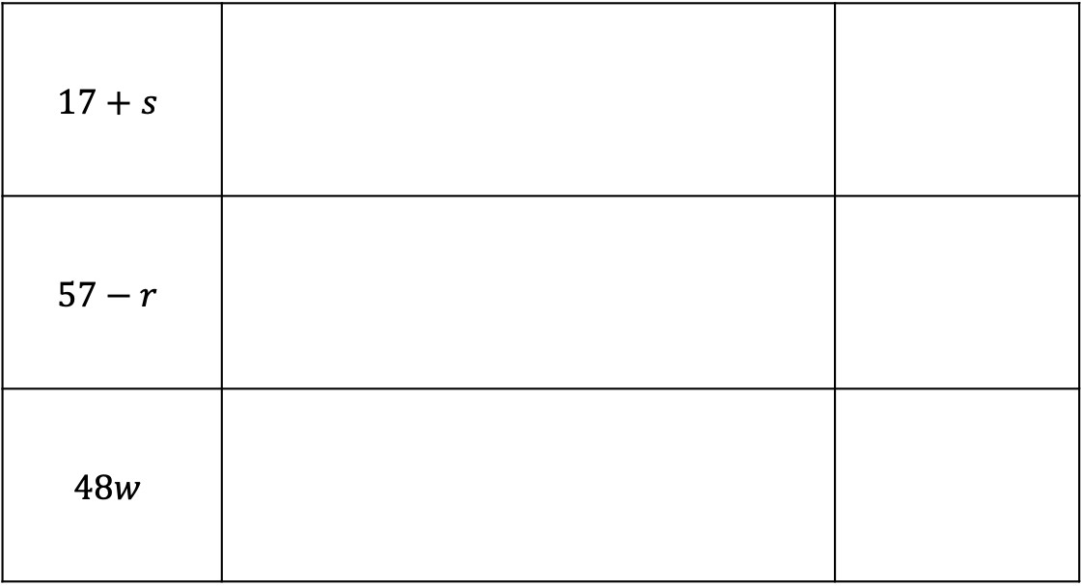
$$17+s$$
$$57−r$$
$$48w$$
volume 2, pg. 305

Slide 14
With your partner, pick four expressions from Question 1 and use them to complete the following table.
Expression | Your Partner’s Scenario | Does the Expression Accurately Represent the Scenario? | Similarities Between Your and Your Partner’s Scenarios for the Expression
 |  | Yes No
 |  | Yes No
volume 2, pg. 305

Slide 15
 |  | Yes No
 |  | Yes No
volume 2, pg. 305

Slide 16
Activity
volume 2, pg. 306

Slide 17

12.5.4 Activity: Gallery Walk
Several scenarios are displayed. For each scenario, write an algebraic expression to match.
Scenario | Expression
volume 2, pg. 306

Slide 18

Wrap-Up
volume 2, pg. 306

Slide 19
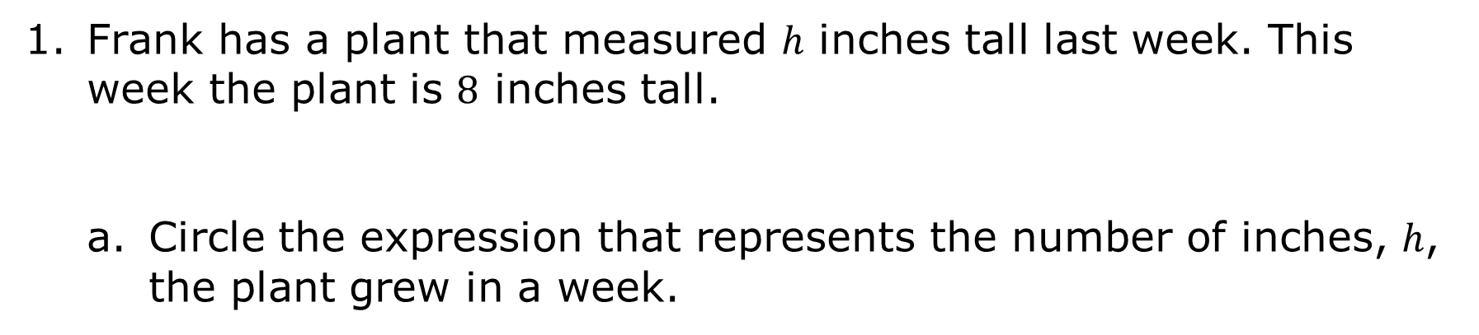
12.5.5 Wrap-Up: Ticket Out the Door
Frank has a plant that measured ℎ inches tall last week. This week the plant is $8$ inches tall.
Circle the expression that represents the number of inches, ℎ, the plant grew in a week.
$$8−h$$ | $$h−8$$
volume 2, pg. 306

Slide 20
Explain your choice.
For the expression not chosen, describe a real-world situation that the expression might represent.
volume 2, pg. 306

